Slide 1
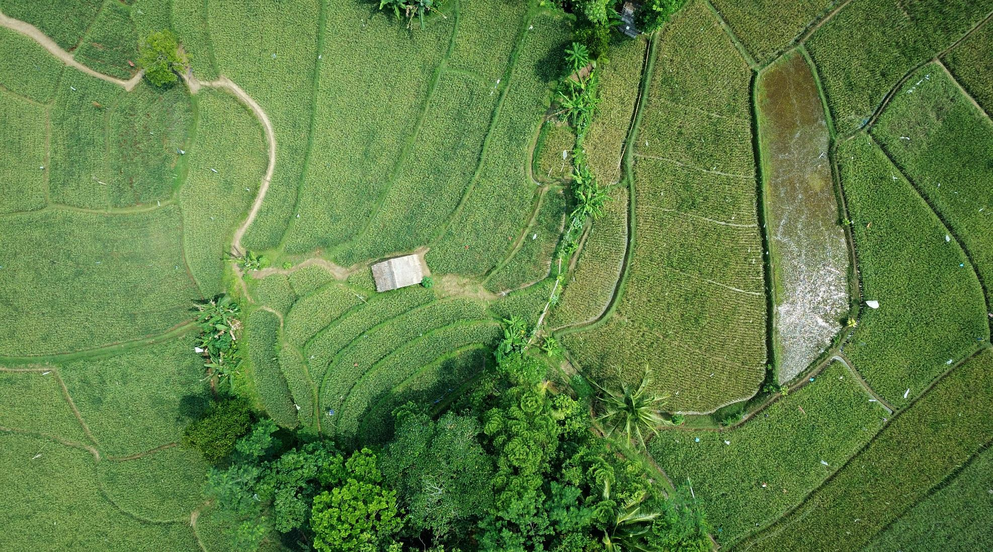

Early crop disease warning and mitigation
AGRIBITERS
Using technology to support farmers..

Slide 2
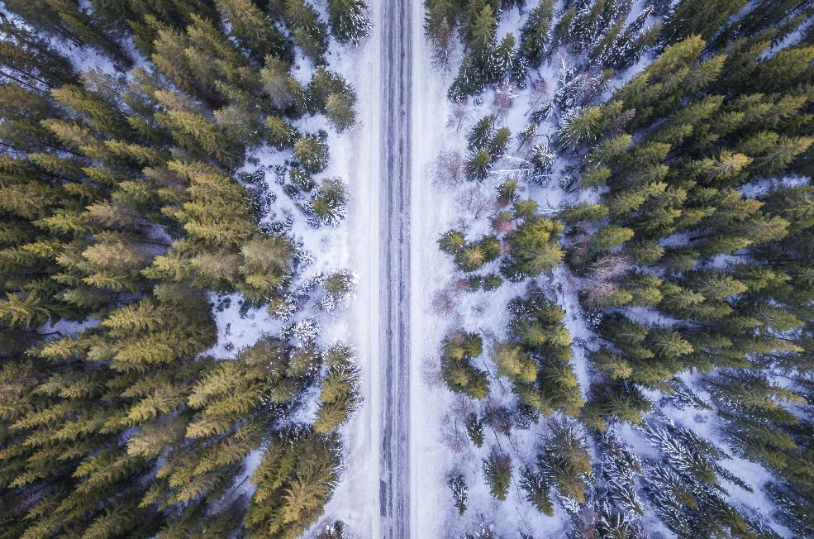
About Us
A major component causing ruin to farmers is the vast variety of diseases that affect crops.
Our main aim is to help farmer bodies identify crops that are susceptible to certain diseases affecting their variety and to provide optimal solutions to prevent them.
Once a farmer or a Krishi Bhavan enrolls with us by giving us the location of area they would like us to survey on, we will start the process of our analysis.
Healthy crops happy farmers!

Slide 3
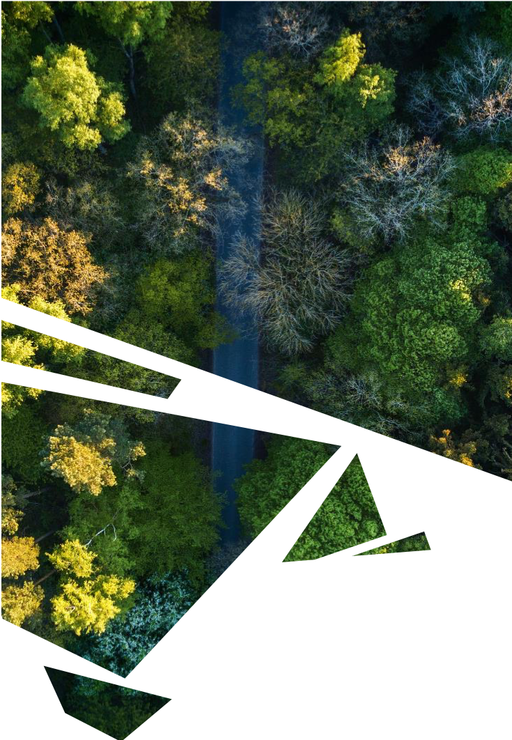



The Problem
Identification of diseases
Manual survey of large areas
Lack of awareness
Diseases cannot be detected by naked eyes in early stage
Impracticality of timely supervision of fields done manually by the farmers
Updation of modern and efficient farming techniques and optimal solutions

Slide 4




The process
Farmer visits our website
We get notified that he has enrolled
We request satellite imagery
We Conduct Analysis
Suggesting optimal solutions
He would have to register with us by providing us details regarding location and contact info
Mail notification will be received and details will be stored in our data base
Contacting external sources like Google Earth and USGS to get satellite imagery
Using image processing and plot analysis tools in python to give early disease warning
Giving inputs to a trained ML model that could suggest the right action to be taken

Slide 5
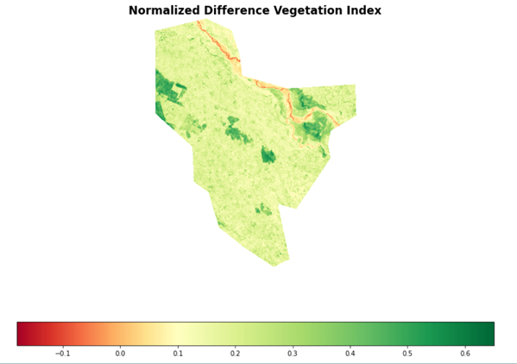
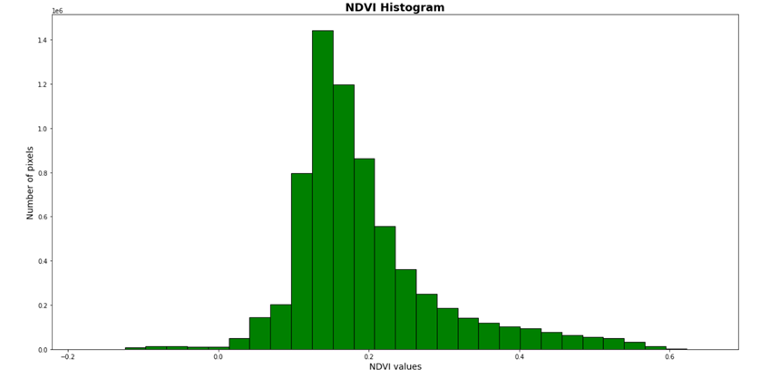
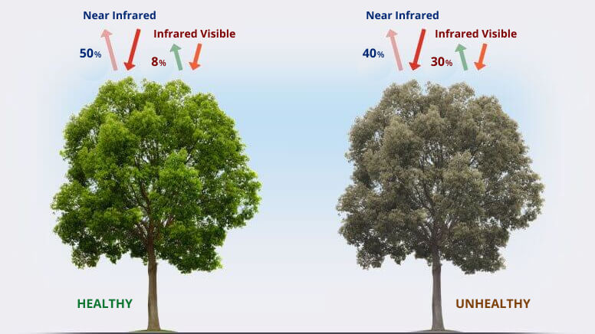
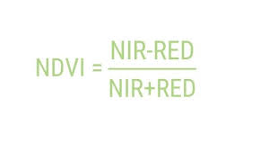
Analysis
Finding NDVI values
NDVI is a measure of the state of plant health based on how the plant reflects light at certain frequencies (some waves are absorbed and others are reflected).
.

Slide 6
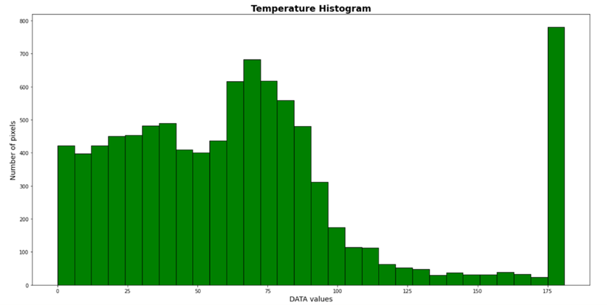
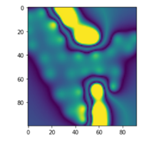


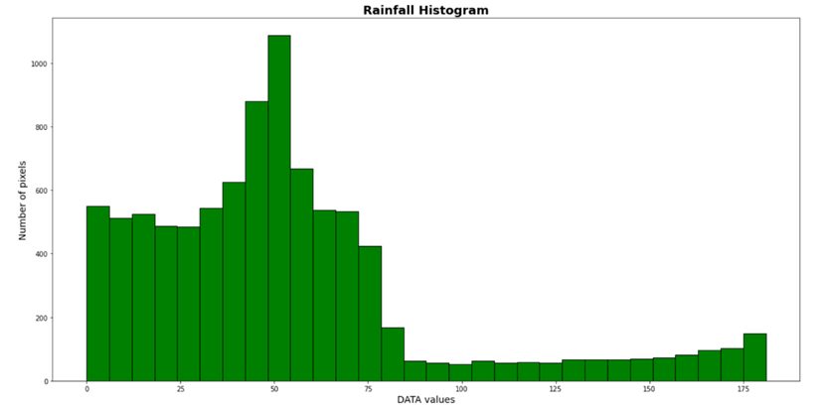
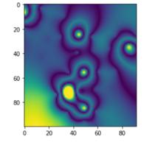

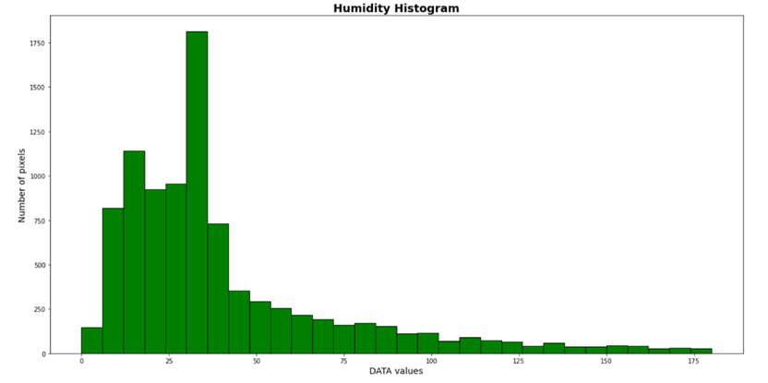
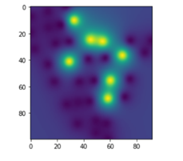

Analysis of weather parameters
Temperature
Redrot: High
Brown rust: Moderate
Grassy shoot: High
Rainfall
Redrot: High
Brown rust: Low
Grassy shoot: Moderate
Humidity
Redrot: High
Brown rust: High
Grassy shoot: Low

Slide 7
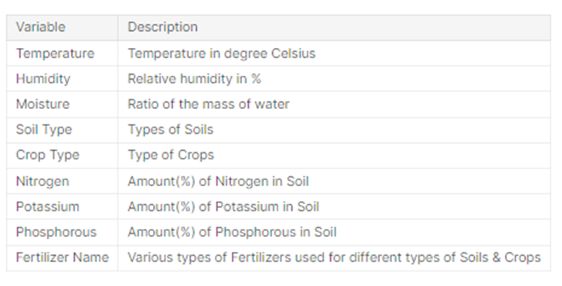
ML Model for Fertilizer Prediction
Dataset attribute features :- Temperature, Humidity, Moisture, Soil Type, Crop Type, Nitrogen, Potassium, Phosphorous.
Attributes Description:

Slide 8
ML Model for Fertilizer Prediction
Soil Type and Crop Type :- categorical features ,Used One Hot Encoding to Encode as a one-hot numeric array.
Temperature, Humidity and Moisture - Image Processing
Model - Random Forest Classifier
Parameters used : -
n_estimators = 100 ,the number of trees in the forest ;
criterion = 'gini' , the function to measure the quality of a split. “gini” is for the Gini impurity
random_state= 42, which Controls both the randomness of the bootstrapping of the samples used when building trees.
Output of ML Model :- Sugggests the best suited fertilizer for the crop according to the habitat conditions

Slide 9
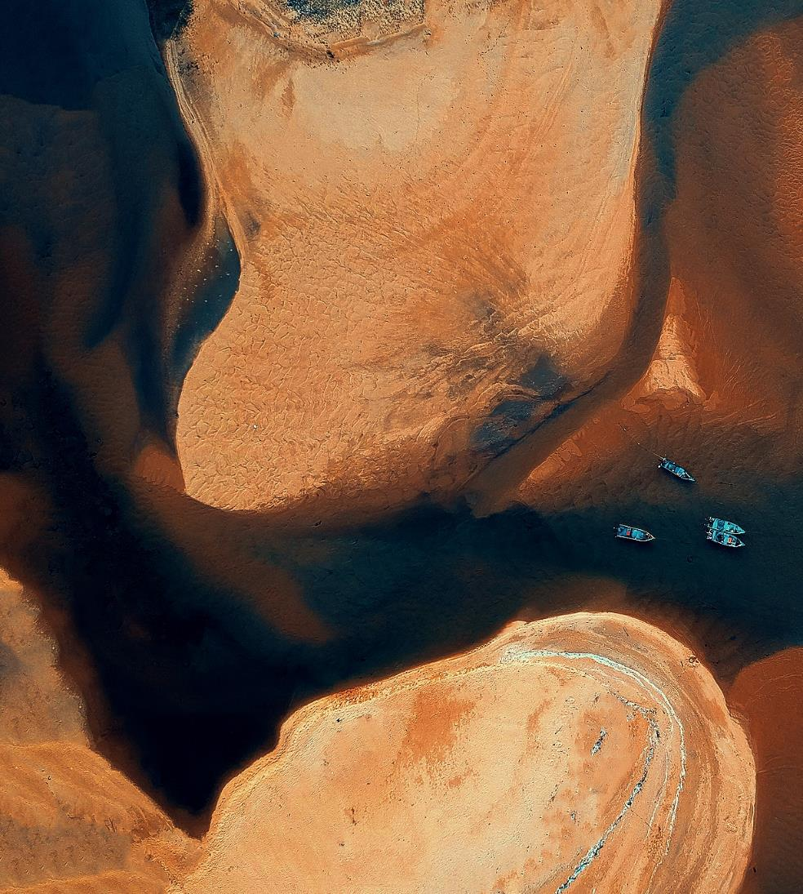
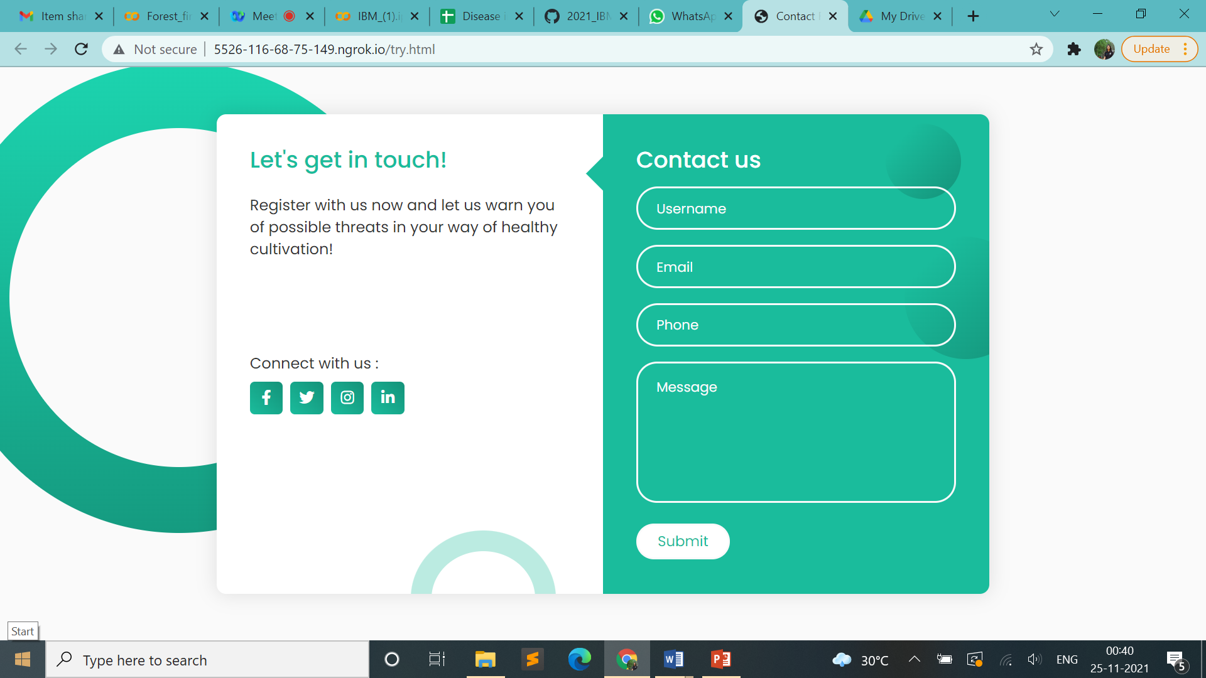
Website
The farmer is required to enroll himself with our website and share his location and contact details.
After the analysis a report will be sent to him via email.

Slide 10



Results
Farmers can take action before noticing any signs of infestation!
Location
Location of possible disease infestation
Percentage of diseases
Optimal solutions
Percentage values of area vulnerable to crop diseases and their types
The right fertilizers to be used based on the detected threat

Slide 11


Scope for improvement
There is an opportunity for success
Data Base
Website development
Complete Automation
Access to larger database with more information regarding diseases as well as weather conditions would yield accurate results
Considering other factors like income availability or resources, growth rate etc.. Specific to different regions and expand networking
Procuring necessary satellite images in a seamlessly integrated manner by gaining access to relevant websites through API

Slide 12



Scope for Automation
There is an opportunity for success
Google Earth
USGS Earth Explorer
SNAP Image processing software
Acquiring KML or shape file of the AoI (Area of interest)
Downloading multi and hyper spectral satellite images with varying resolution and satellite selection
Choosing necessary bands required for processing the image and exporting it in GeoTiff format

Slide 13

Summary
The use of modern technology in agriculture comes with a lot of benefits.
Higher crop productivity, decreased use of water, fertilizer, and pesticides, which in turn keeps food prices down, reduced impact on natural ecosystems, less runoff of chemicals into rivers and groundwater etc..
Modern agriculture has become an amazing industry that merits the respect and gratitude of every citizen.
Paving the way to efficient farming

Slide 14
Acknowledgement
We wish to express our sincere gratitude to IBM for providing us an opportunity to work on this project that helped us broaden our knowledge and enrich our experience in the world of technology.
We sincerely thank Mr. Prashanth Farkya and Ms. Shefali Vaish for their guidance and encouragement in carrying out this project work and helping us bring out the best in us.
We would also like to thank the panel of judges, programme coordinators and hosts who have made this event a success.

Slide 15
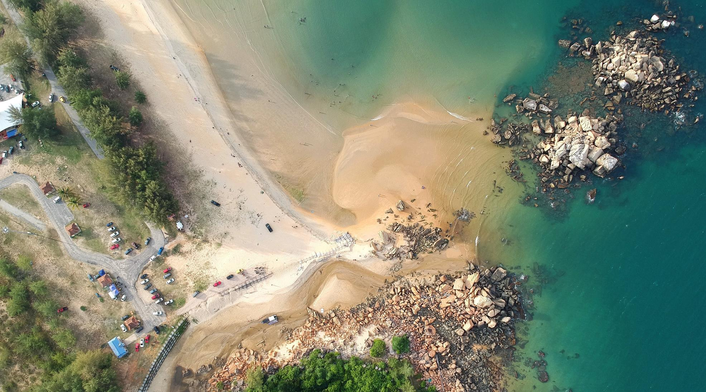
Thank You
Ananya KV
Reshma Santhosh
Aswathy S Kumar
Govind S
Sreelakshmi P

